Slide 1
Generic Crypto-Portfolio
Final Project Presentation
By
Generic Team Name

Slide 2
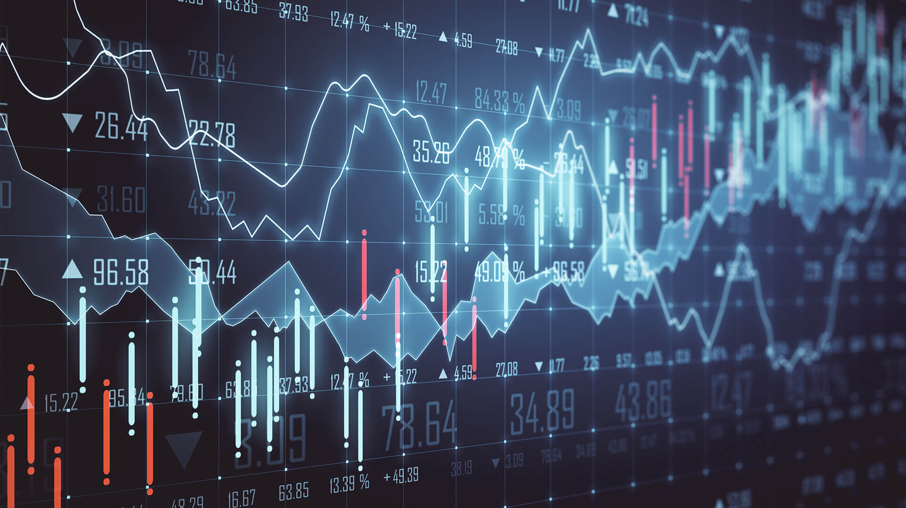
What is Generic Crypto-Portfolio?
Solution for both advanced investors and for beginners who are just starting their adventure with cryptocurrencies
Innovative use of machine learning to predict the unpredictable
Lots of data, both in the form of statistics and visualizations

Slide 3
Why would people use it?
Cryptocurrencies are becoming more and more popular
The amount of investors increases every day
Storing your portfolio in excel file is outdated
Investing in crypto can be overwhelming, why not let the algorithm guide you through it

Slide 4
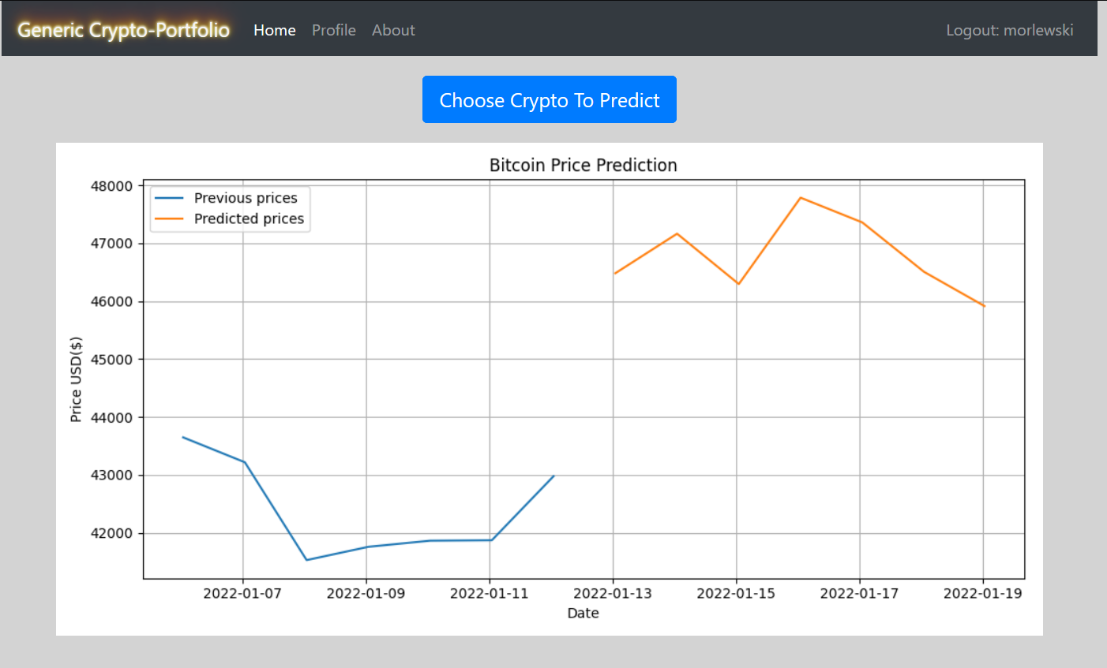
Product in action

Slide 5
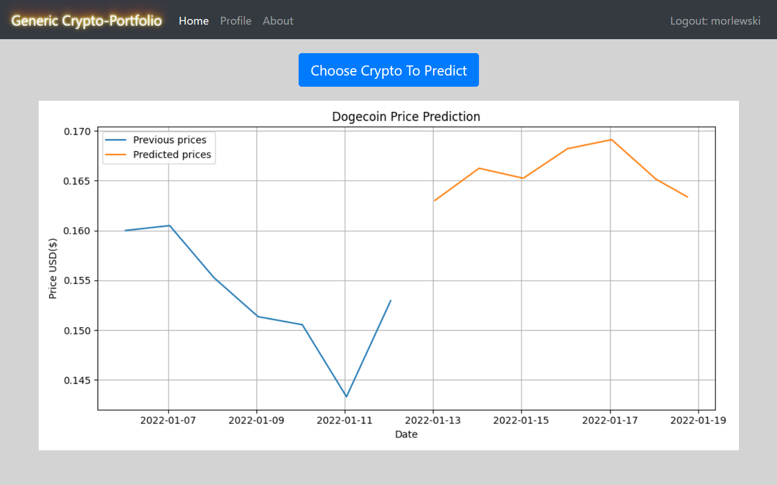

Slide 6
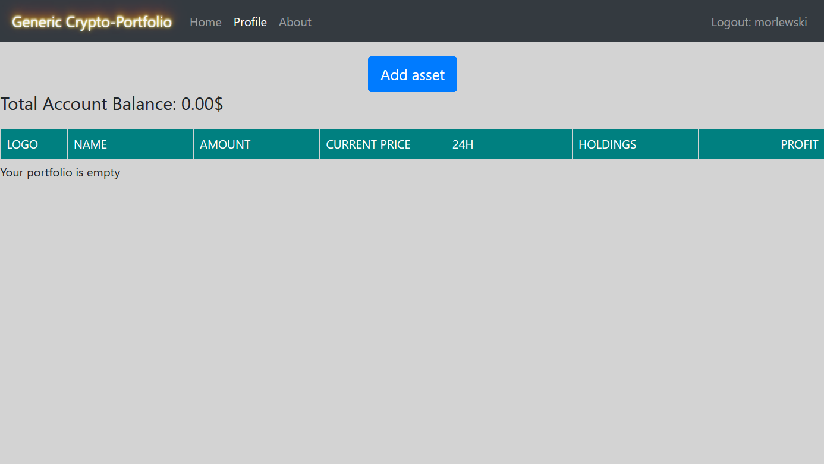

Slide 7
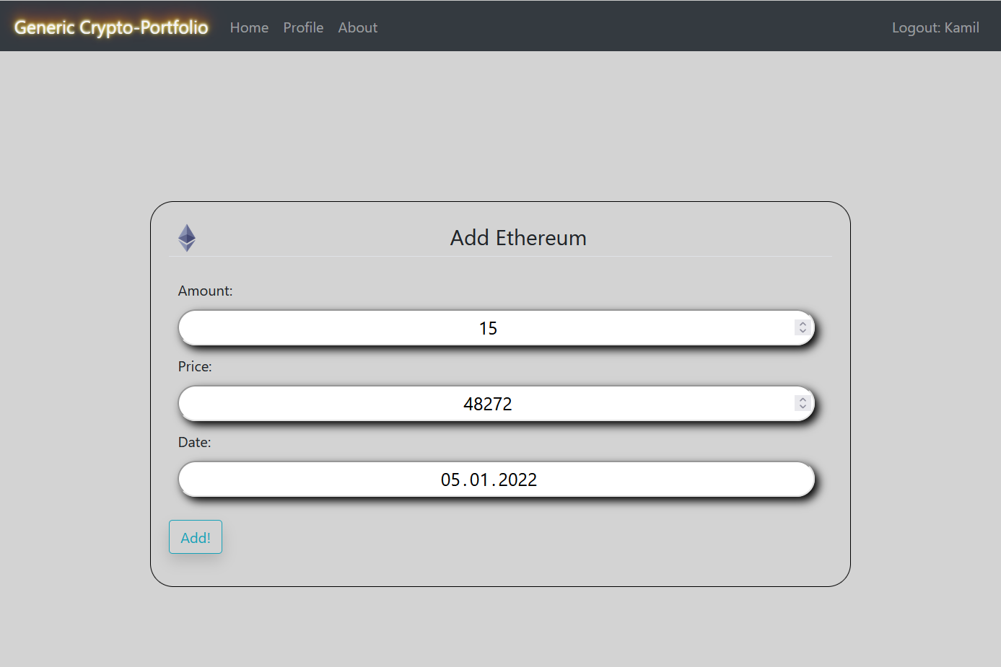

Slide 8
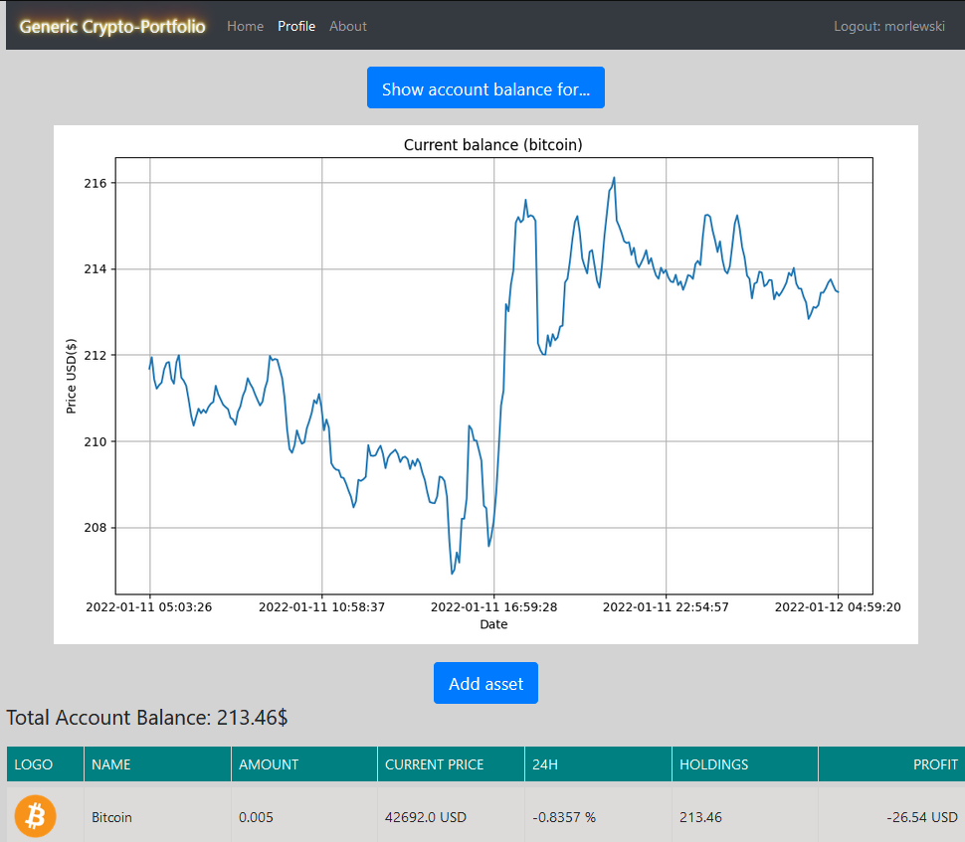

Slide 9
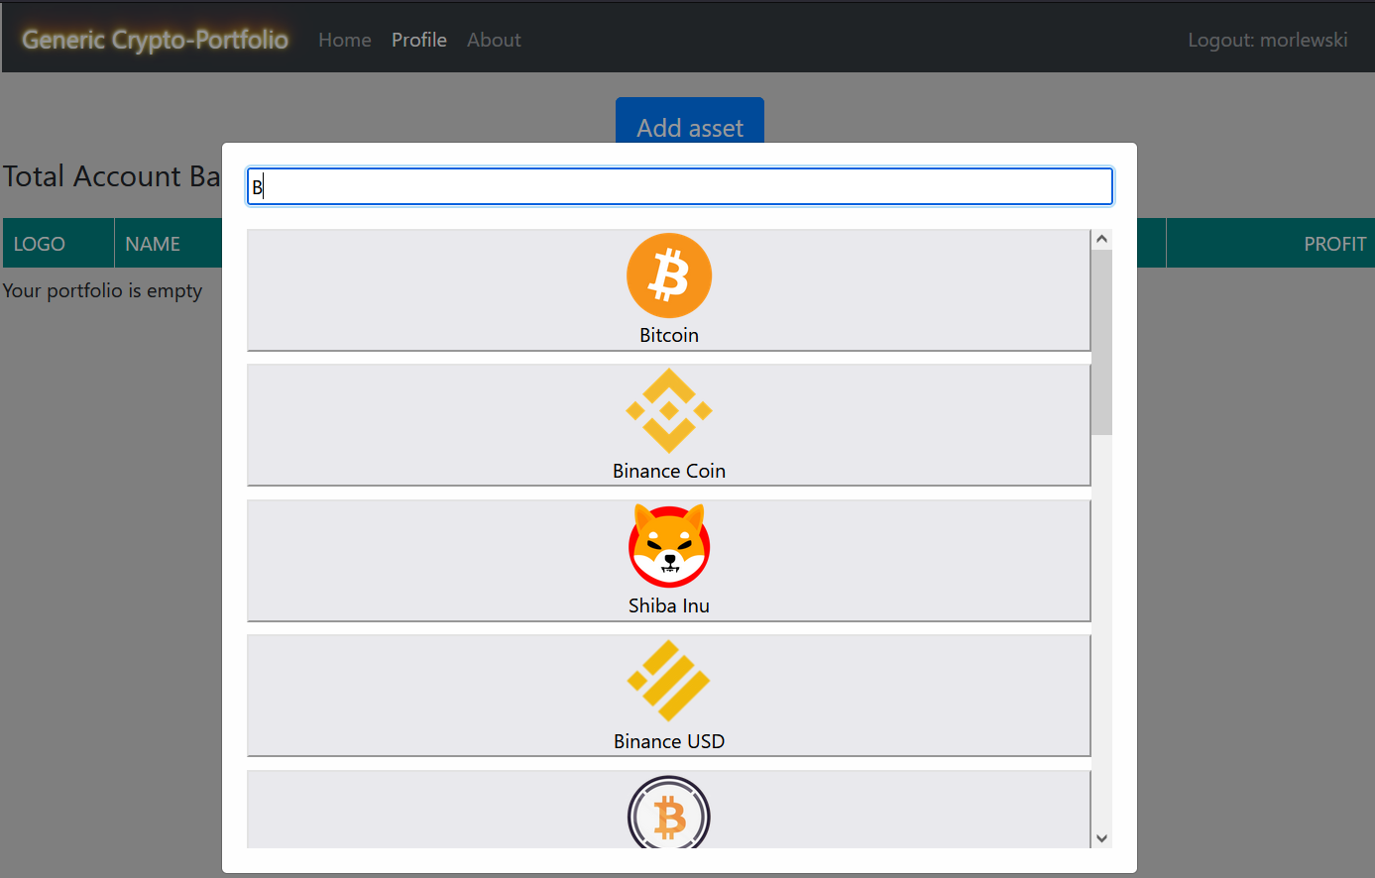

Slide 10
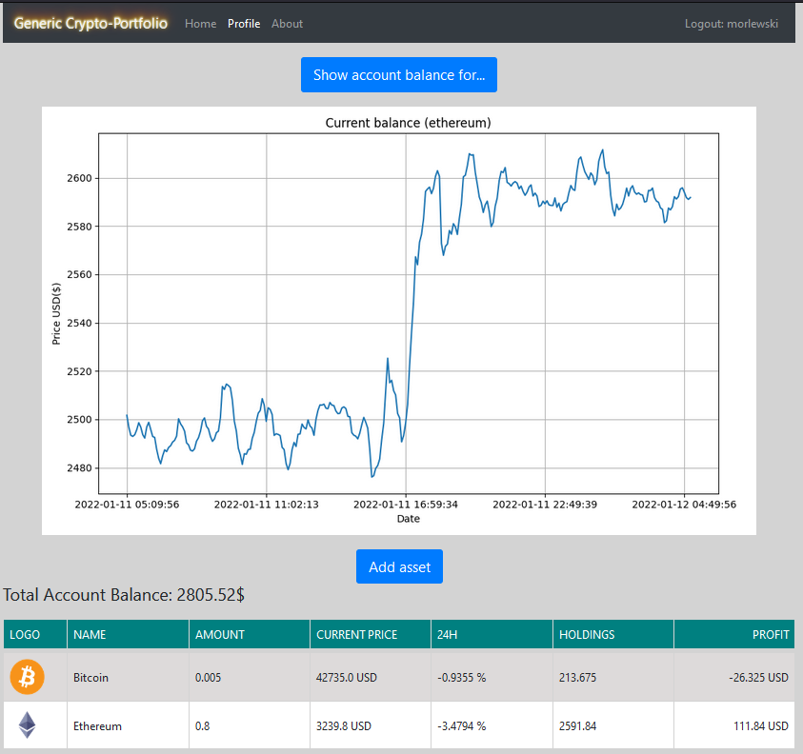

Slide 11
Questions?

